Slide 1



NIST IR 8228
Managing IoT Cybersecurity and Privacy Risks
Device
Data
Privacy
Justin Martin
IT 490 Capstone Week 4
October 12, 2026

Slide 2


What NIST IR 8228 Covers
A June 2019 NIST report that helps organizations assess cybersecurity and privacy risks for individual IoT devices throughout their lifecycles.
IoT devices connect digital systems to the physical world
The report supports existing risk management
Sensors collect measurements. Actuators change physical conditions. Network interfaces connect devices to other systems.
Organizations use it to identify gaps in their current practices and adapt controls to each device and its purpose.
Boeckl et al. (2019), §1 and §2

Slide 3



Why IoT Changes Risk Management
Physical effects
Different management options
Uneven security and privacy capabilities
A compromised lock or temperature controller can disrupt operations. Security changes also need to respect safety and availability.
Some devices lack familiar administration tools, useful logs, or a way to install endpoint security software.
Update support and access controls vary. A device may need protections outside the device itself.
Boeckl et al. (2019), §3.1–§3.3

Slide 4
Cybersecurity and Privacy Risks
Cybersecurity
Privacy
Protects devices and data against compromise.
Examines how processing personal information can harm people, including authorized use.
Example: An attacker steals recordings or takes control of a connected camera.
Example: A company keeps employee movement records for an unnecessary purpose.
Strong encryption protects records, but it does not decide whether collecting those records is appropriate.
Boeckl et al. (2019), §3

Slide 5
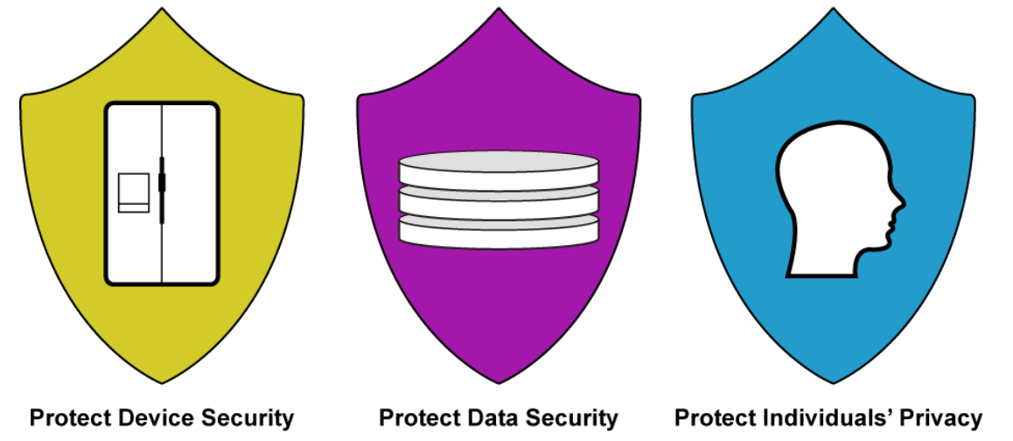
The Three Risk Mitigation Goals
Device security prevents misuse of the device. Data security protects information. Privacy addresses the effects of processing information about people.
Boeckl et al. (2019), §4, Figure 4, p. 11

Slide 6



Use Across the Device Lifecycle
1 Before purchase
2 During operation
3 At retirement
Identify the purpose, device owner, data collected, and vendor support period. Confirm that required protections are available.
Apply approved configurations, restrict access, monitor available logs, and manage updates around operational needs.
Remove credentials and network access. Erase stored data and address copies held in vendor services according to retention rules.
Boeckl et al. (2019), §5.1–§5.2

Slide 7
Company ABC IoT Scenario
Seattle and Denver add connected security cameras and badge readers. The devices support building security and send records to a managed service.
Device risk
Data risk
Privacy risk
Unauthorized access could change camera settings or interfere with building access.
Video and badge records can expose employee identities and movement patterns.
Even authorized access can create problems if staff use records beyond their approved purpose.
Original scenario applying Boeckl et al. (2019), §§3–5

Slide 8
Controls for Company ABC
Risk area | Example control | Evidence to review
Device security | Isolate devices and restrict management access | Inventory, access rules, update records
Data security | Encrypt transfers and limit access to stored records | Configuration and access logs
Privacy | Limit collection, retention, and approved uses | Data map and retention policy
Vendor dependency | Review support terms and remote access | Support dates and vendor agreement
These examples depend on the devices and business requirements. They are not a universal checklist.
Illustrative controls applying Boeckl et al. (2019), §4 and §5

Slide 9



Ownership and Risk Decisions
Business and facilities teams
IT and security teams
Privacy and procurement teams
Explain what each device must do and which operational disruptions the organization can tolerate.
Track devices, assess technical limitations, and maintain controls that fit the environment.
Review personal information processing and vendor commitments. Assign an accountable owner for unresolved risk.
Boeckl et al. (2019), §5

Slide 10
What I Take From the Report
A connected device needs an owner and a risk decision.
For Company ABC, the first step is understanding what each device does and where its data goes. That gives the organization a basis for choosing controls and deciding whether the remaining risk is acceptable.
The same review continues when device use, vendor support, or business needs change.
Boeckl et al. (2019), §5

Slide 11
References
Boeckl, K., Fagan, M., Fisher, W., Lefkovitz, N., Megas, K. N., Nadeau, E., Piccarreta, B., O’Rourke, D. G., & Scarfone, K. (2019). Considerations for managing Internet of Things (IoT) cybersecurity and privacy risks (NISTIR 8228). National Institute of Standards and Technology. https://doi.org/10.6028/NIST.IR.8228
Illustration credits
Slide 5. Figure 4, Risk Mitigation Goals. From Considerations for managing Internet of Things (IoT) cybersecurity and privacy risks (p. 11), by K. Boeckl et al., 2019, National Institute of Standards and Technology (https://doi.org/10.6028/NIST.IR.8228). In the public domain.
Icons. Font Awesome Free by Fonticons, Inc., licensed under CC BY 4.0. https://fontawesome.com/license/free
Company ABC examples and slide layouts are original applications of the report.

